Slide 1

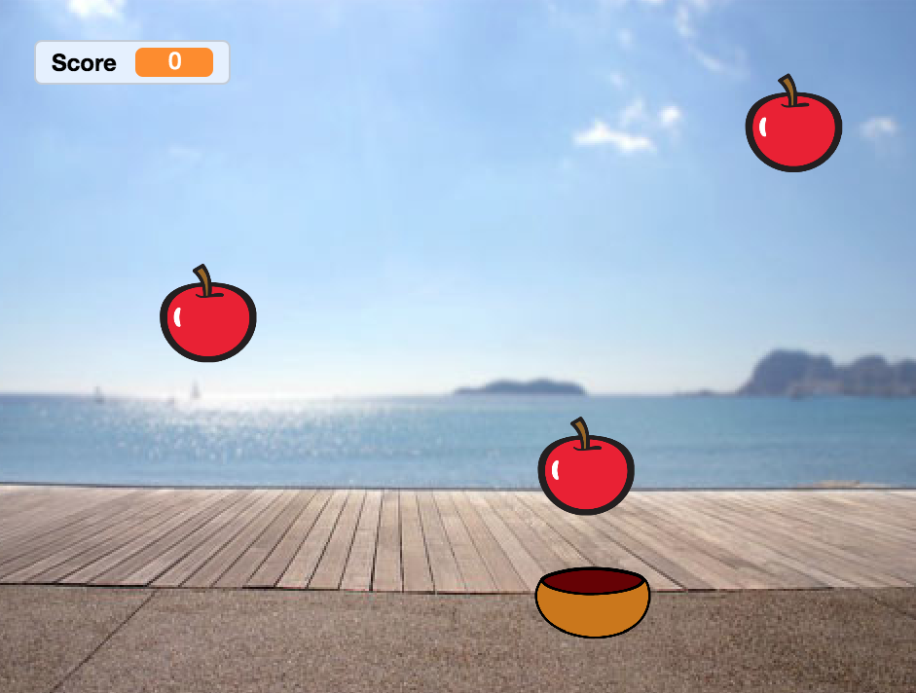
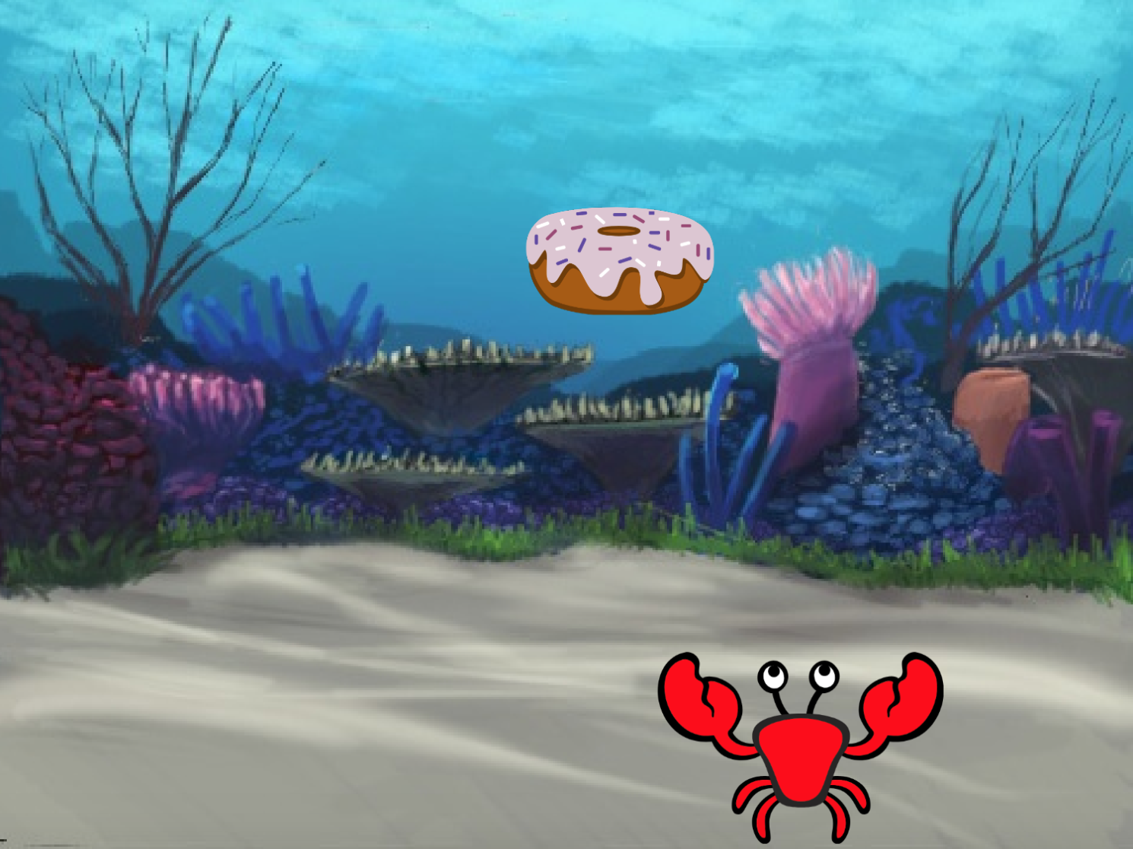

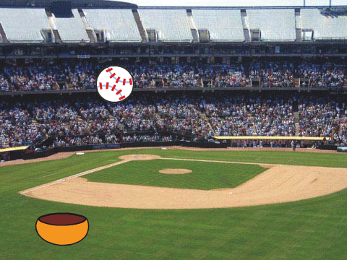
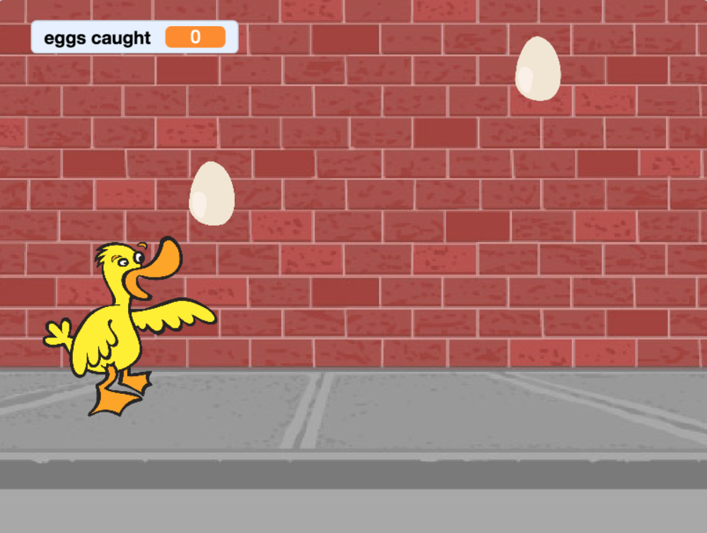


Catch Game Cards
Make a game where you catch things falling from the sky.
yyyymmdd
scratch.mit.edu
Set of 7 cards

Slide 2
Catch Game Cards
Use these cards in this order:
Go to the Top
Fall Down
Move the Catcher
Catch It!
Keep Score
Bonus Points
You Win!
scratch.mit.edu
Set of 7 cards

Slide 3


Go to the Top
Start from a random spot at the top of the Stage.
yyyymmdd
Catch Game
1

Slide 4






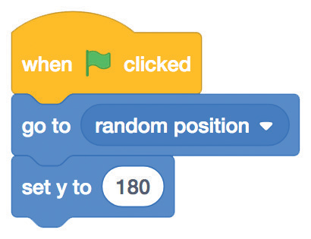

Go to the Top
scratch.mit.edu
GET READY
Choose a backdrop, like Boardwalk.
Boardwalk
Choose a sprite, like Apple.
Apple
ADD THIS CODE
Apple
Type 180 to go to the top of the stage.
TRY IT
Click the green flag to start.
y is the position on the Stage from top to bottom.
TIP
y = 180
x = –240
x = 240
y = –180

Slide 5


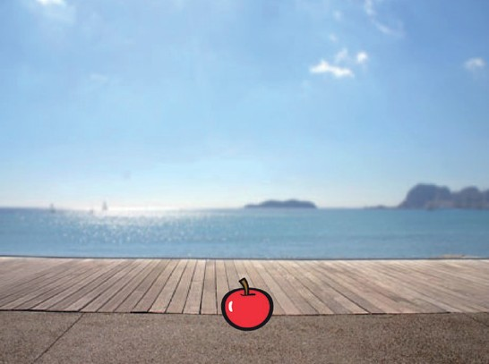
Fall Down
Make your sprite fall down.
yyyymmdd
Catch Game
2

Slide 6
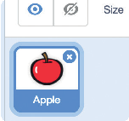
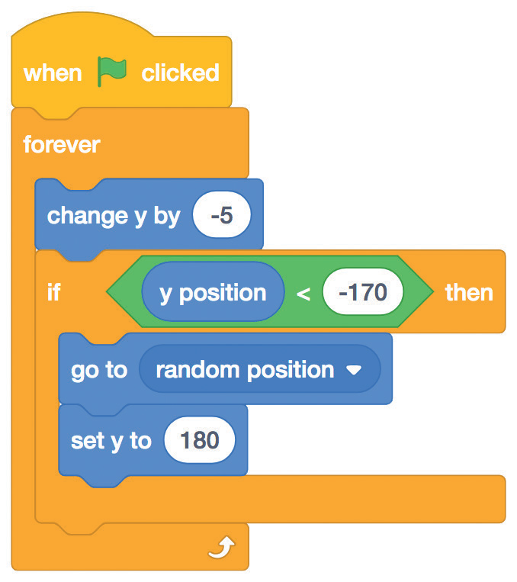
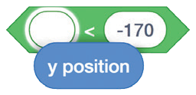


Fall Down
scratch.mit.edu
GET READY
Click to select the Apple sprite.
ADD THIS CODE
Keep the previous code as is, and add this second stack of blocks:
Type a minus sign to fall down.
Apple
Check if near the bottom of the Stage.
Insert the y position block into this block from the Operators category.
Go back to the top of the Stage.
TRY IT
Click the green flag to start.
Click the stop sign to stop.
TIP
Use
to move up or down.

Slide 7
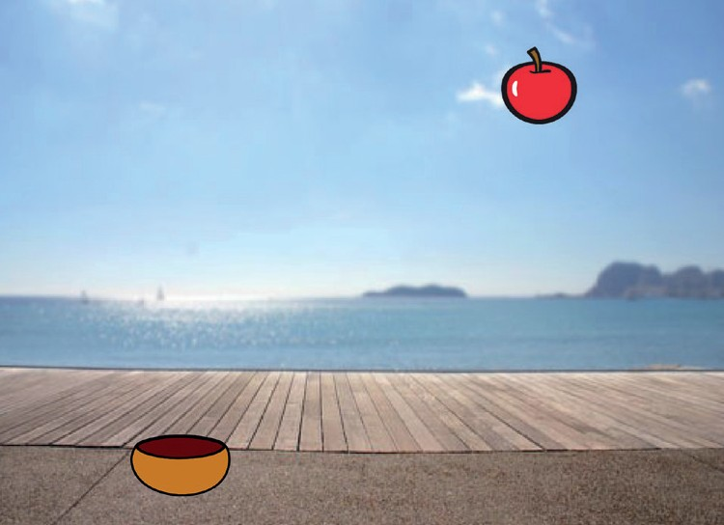
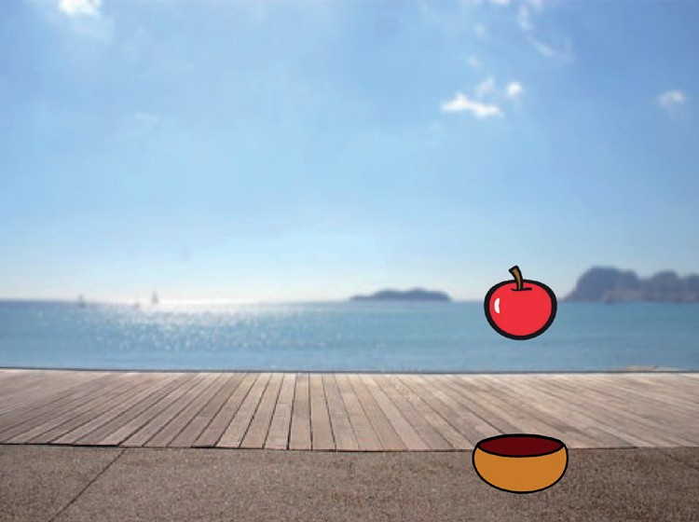
Move the Catcher
Press the arrow keys so that the catcher moves left and right.
yyyymmdd
Catch Game
3

Slide 8


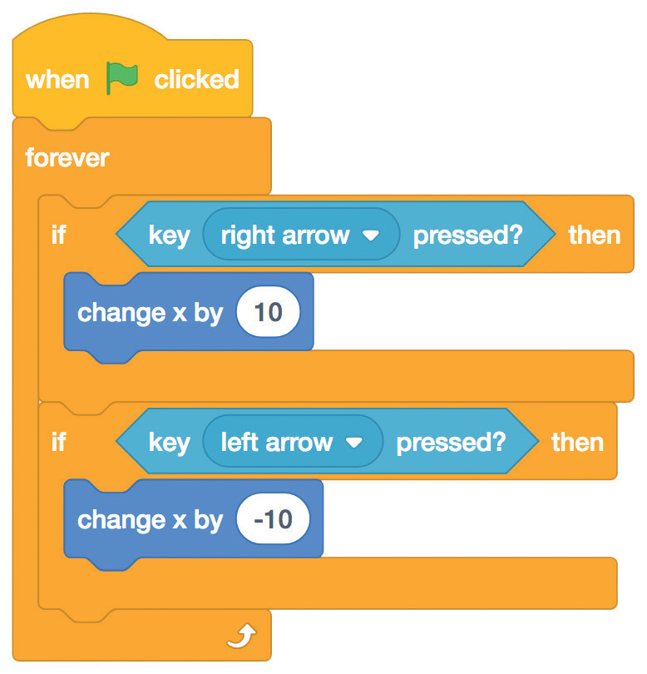




Move the Catcher
scratch.mit.edu
GET READY
Drag the bowl to the bottom of the Stage.
Choose a catcher, like Bowl.
Bowl
ADD THIS CODE
Choose the right arrow
from the menu.
Bowl
Choose the left arrow
from the menu.
TRY IT
Click the green flag to start.
Press the arrow keys to move the catcher.

Slide 9
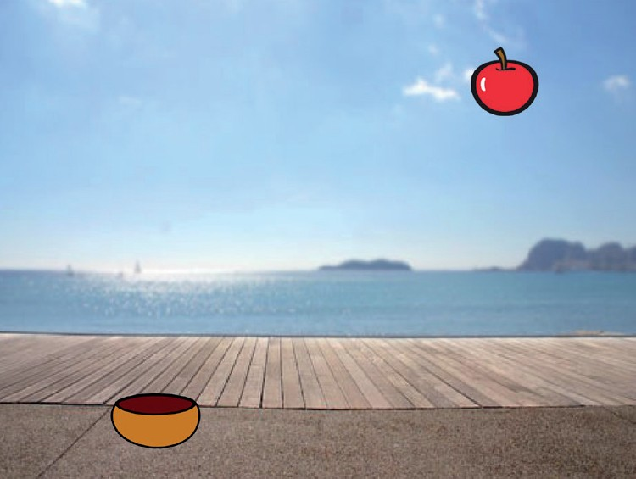

Catch It!
Catch the falling sprite.
yyyymmdd
Catch Game
4

Slide 10
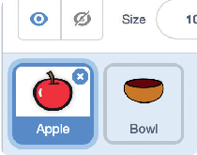
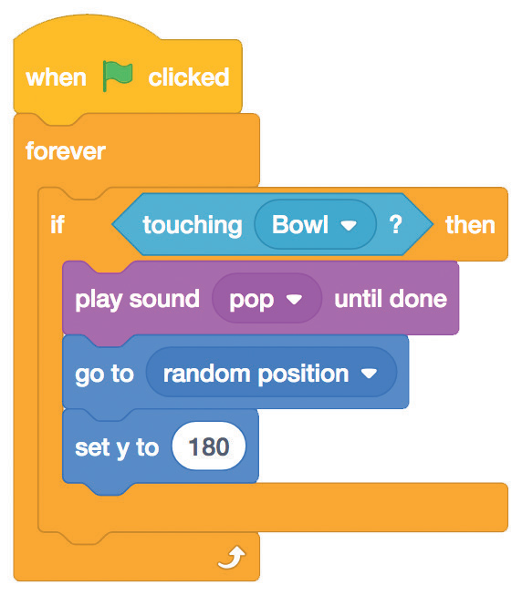



Catch It!
scratch.mit.edu
GET READY
Click to select the Apple.
ADD THIS CODE
Choose Bowl from the menu.
Apple
Choose a sound.
TIP
Click the Sounds tab if you want to add a different sound.
Click the Code tab when you want to add more blocks.
Then choose a sound from the Sounds Library.

Slide 11
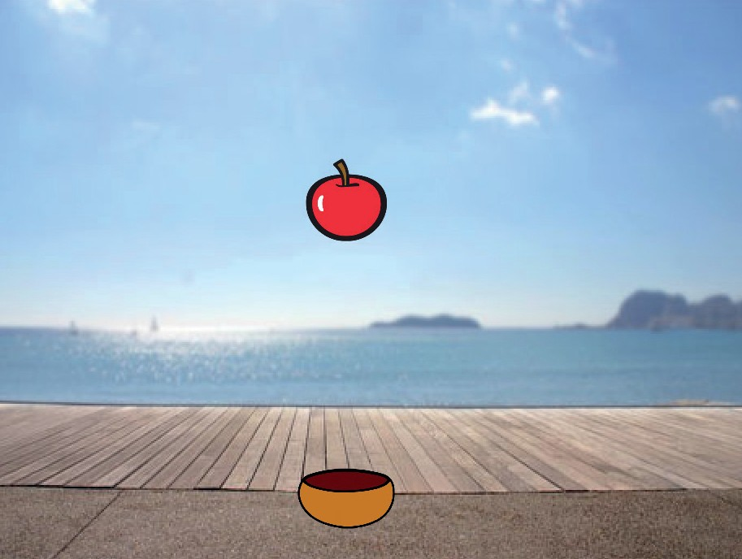

Keep Score
Add a point each time you catch the falling sprite.
yyyymmdd
Catch Game
5

Slide 12
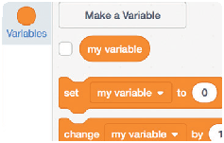
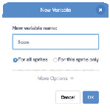
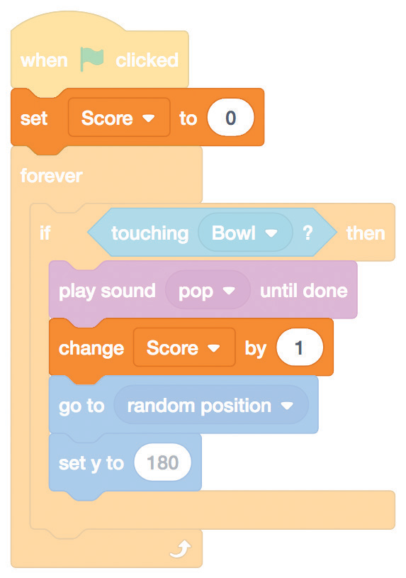

Keep Score
scratch.mit.edu
GET READY
Choose Variables.
Name this variable Score and then click OK.
Click the Make a Variable button.
Score
ADD THIS CODE
Add two new blocks to your code:
Apple
Add this block to reset the score.
Choose Score from the menu.
Add this block to increase the score.
TRY IT
Click the green flag to start.
Then, catch apples to score points!

Slide 13
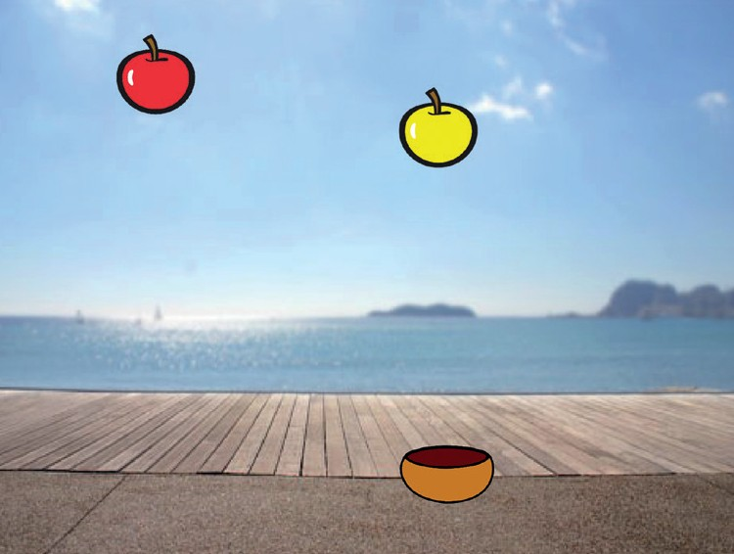
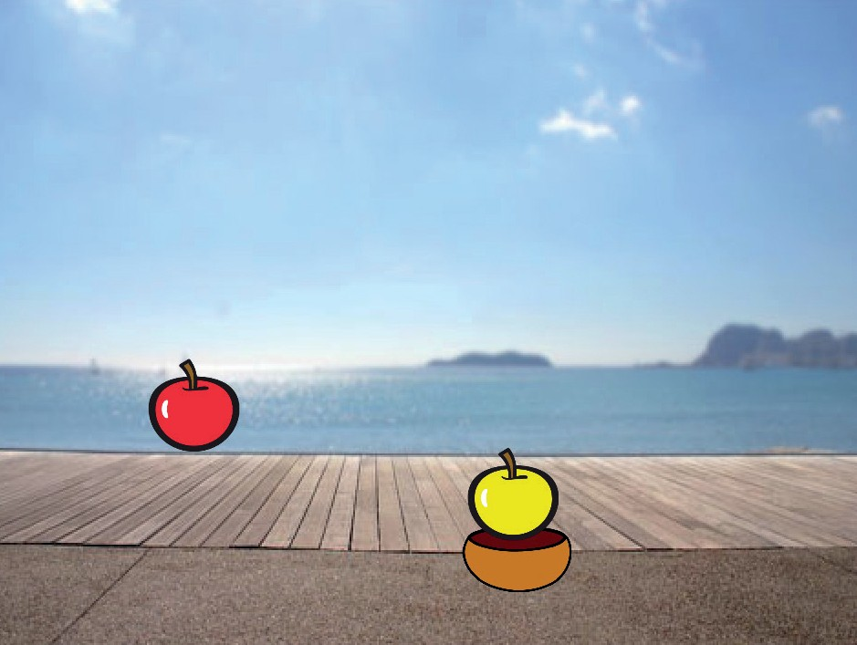
Bonus Points
Get extra points when you catch a golden sprite.
yyyymmdd
Catch Game
6

Slide 14

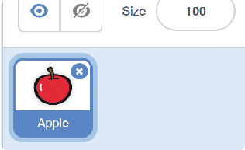

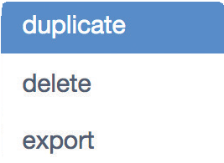


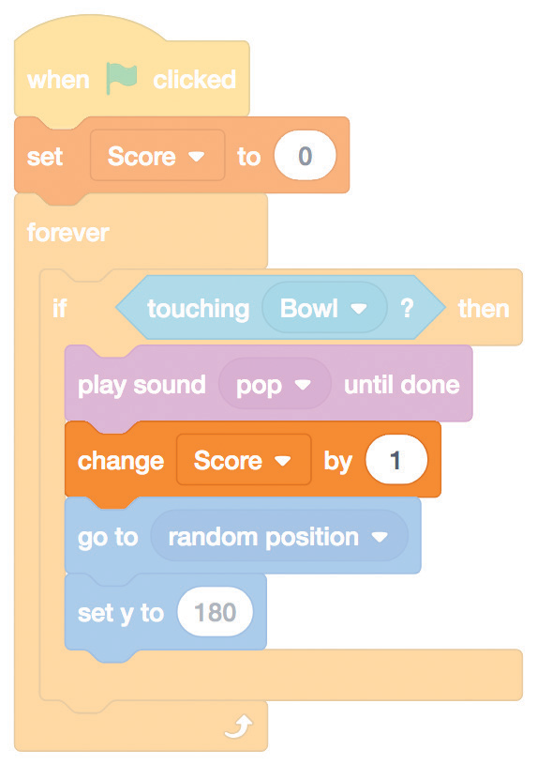
Bonus Points
scratch.mit.edu
GET READY
To duplicate your sprite,
right-click (Mac: control+click).
Click the Costumes tab.
You can use the paint tools to make your bonus sprite look different.
Choose duplicate.
ADD THIS CODE
Click the Code tab.
Apple2
Type how many points you get for catching a bonus sprite.
TRY IT
Catch the bonus sprite to increase your score!

Slide 15

You Win!
When you score enough points, display a winning message!
yyyymmdd
Catch Game
7

Slide 16
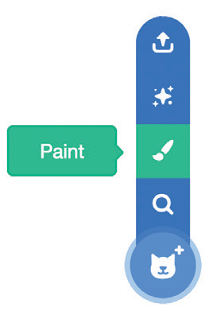


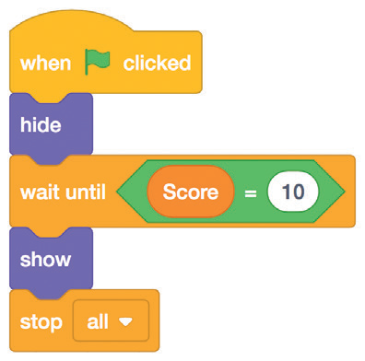


You Win!
scratch.mit.edu
GET READY
Use the Text tool to write a message, like “You Win!”
Click the Paint icon to make a new sprite.
You can change the font color, size, and style.
ADD THIS CODE
Click the Code tab.
Insert the Score block from the Variables category.
Sprite2
TRY IT
Click the green flag to start.
Play until you score enough points to win!

